Slide 1

WaveCoN
TELECOM ANALYSIS
Presented By Bhavani

Slide 2
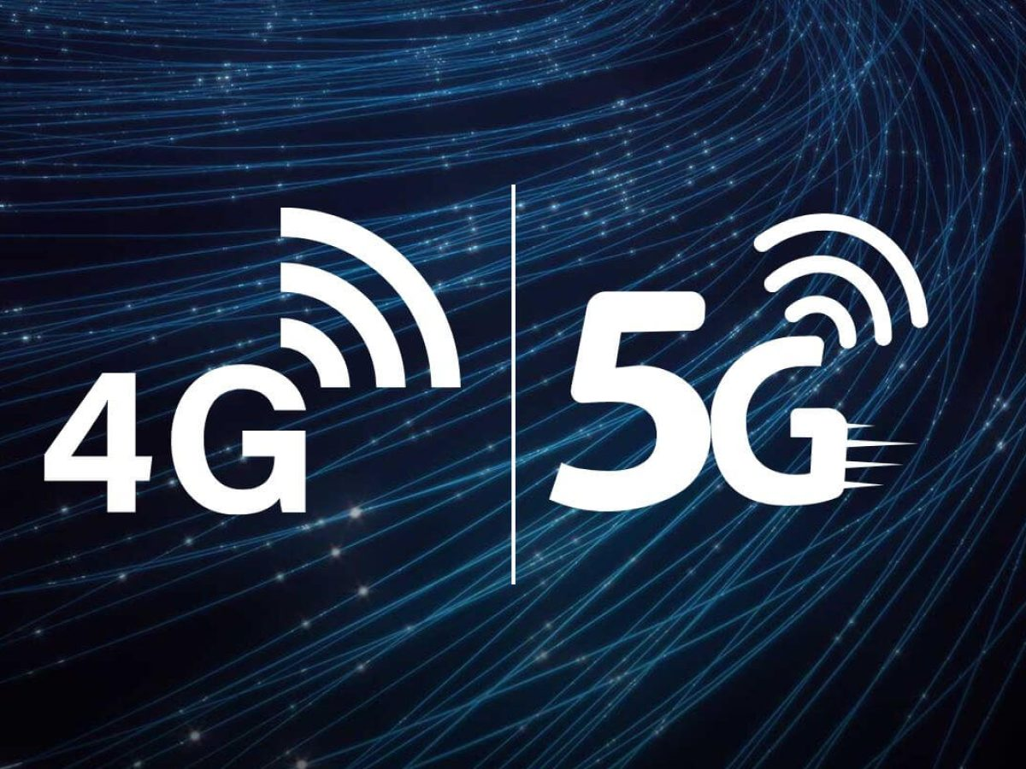
About Wavecon
Wavecon is a top telecom company having launched 5G services despite the overwhelming success of the 5G launch, WaveCon remains vigilant in monitoring key performance indicators (KPIs) to ensure continued success. Through rigorous analysis and optimization, WaveCon identifies areas for improvement and implements strategic initiatives to maximize performance post-5G launch.

Slide 3
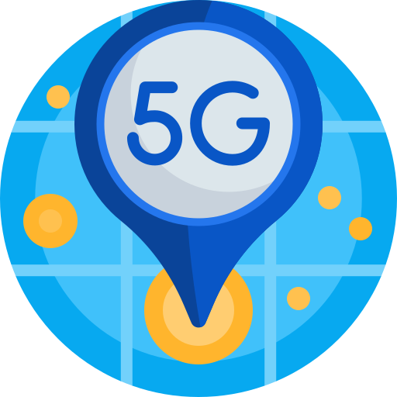
Objectives
What is the impact of the 5G launch on our revenue?
Which KPI is underperforming after the 5G launch?
After the 5G launch, which plans are performing well in terms of revenue? Which plans are not performing well?
Is there any plan affected largely by the 5G launch? Should we continue or discontinue that plan?
Is there any plan that is discontinued after the 5G launch? What is the reason for it?

Slide 4
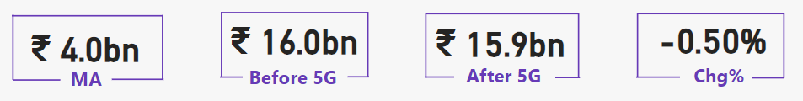
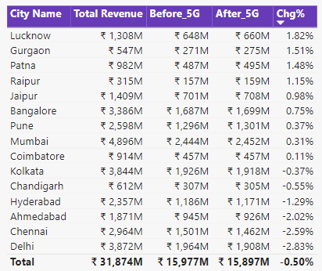

What is the impact of the 5G launch on our revenue?
Before 5G launch, the value of revenue was 16.0 Billion. After 5G launch, the revenue decreased to 15.9 Billion, with a change of -0.5%.
After the implementation of 5G, there was a revenue increase of +1.82% in Lucknow and a revenue decrease of -2.83% in Delhi.

Slide 5
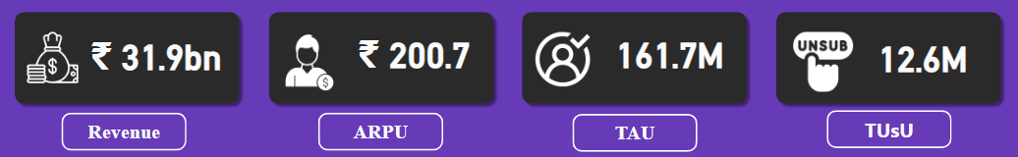
Key Performance Indicator
Total revenue generated is Rs. 31.9 Billion
Average Revenue Per User (ARPU) is Rs. 200.7
Total Active Users (TAU) is 161.7 Million
Total Unsubscribed Users (TUsU) is 12.6 Million

Slide 6
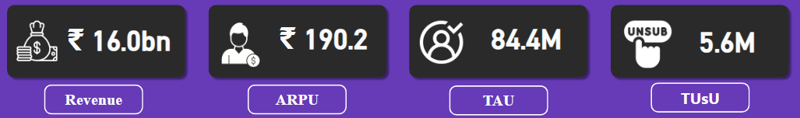
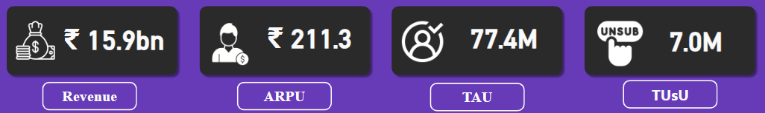
Which KPI is underperforming after the 5G launch?
Before 5G Launch
After 5G implementation, Total Active Users(TAU) decreased by -8.29% from 84.4 million to 77.4 million. Total Unsubscribed Users (TUsU) increased by +25% from 5.6 million to 7 million.
After 5G Launch

Slide 7
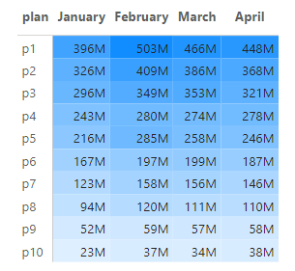
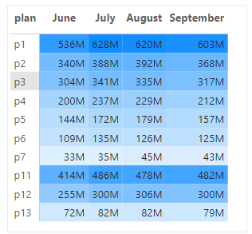
After the 5G launch, which plans are performing well in terms of revenue? Which plans are not performing well?
Before 5G Launch
After 5G Launch
After 5G launch, p1,p11,p12 are performing well in terms of revenue. The major declined plan is p7 in revenue .
P4,P5,P6 plans are slightly declined.

Slide 8
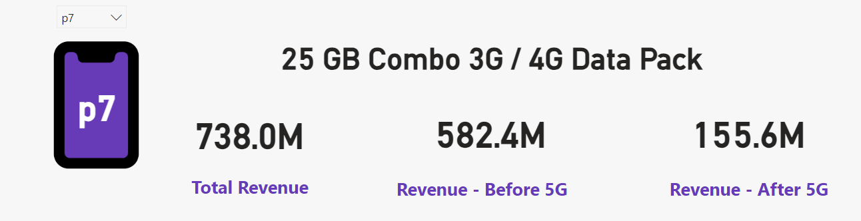
Is there any plan affected largely by the 5G launch? Should we continue or discontinue that plan?
After 5G launch, P7 is largely affected with revenue declining from 582.4 million to 155.6 million.

Slide 9
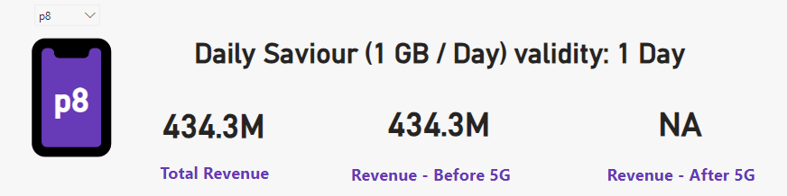
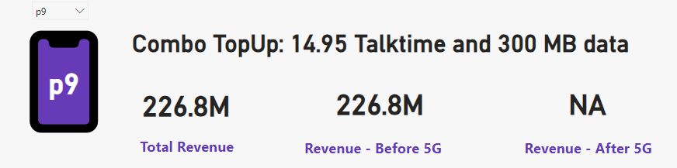
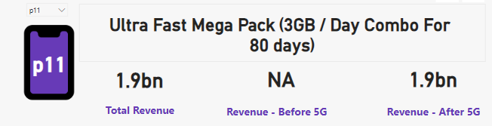
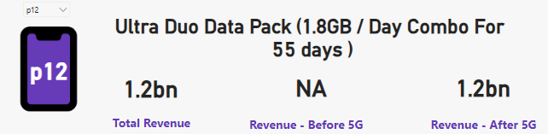
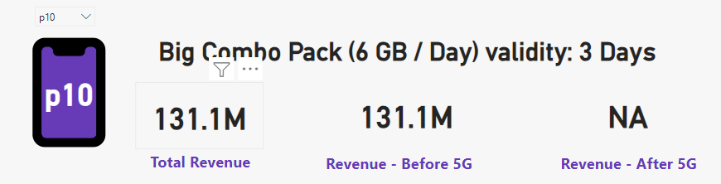
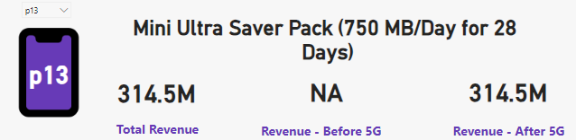
Is there any plan that is discontinued after the 5G launch? What is the reason for it?
P8,P9 and P10 plans are discontinued after 5G launch The new plans were added in launch of 5G those are P11,P12 and P13

Slide 10
Thank You

